Slide 1
CONTROL CONDITION

Slide 2
Question 1

Slide 3
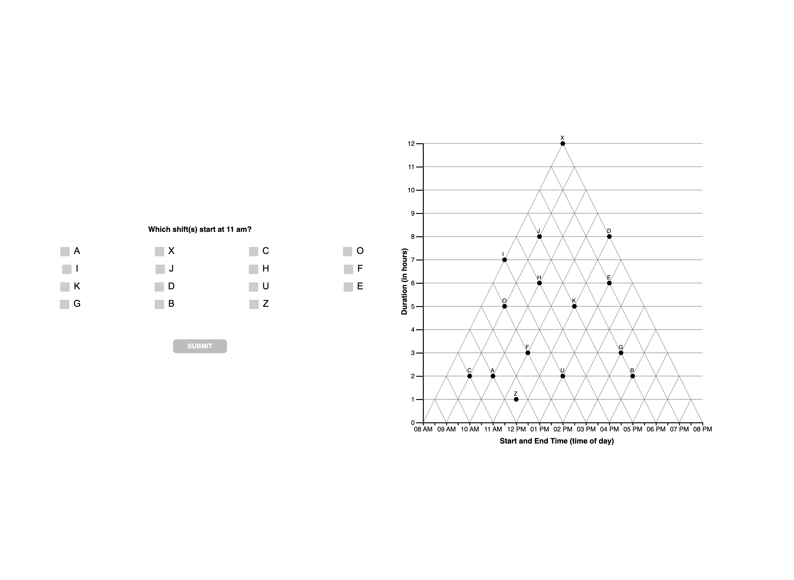

Slide 6
Question 2

Slide 7
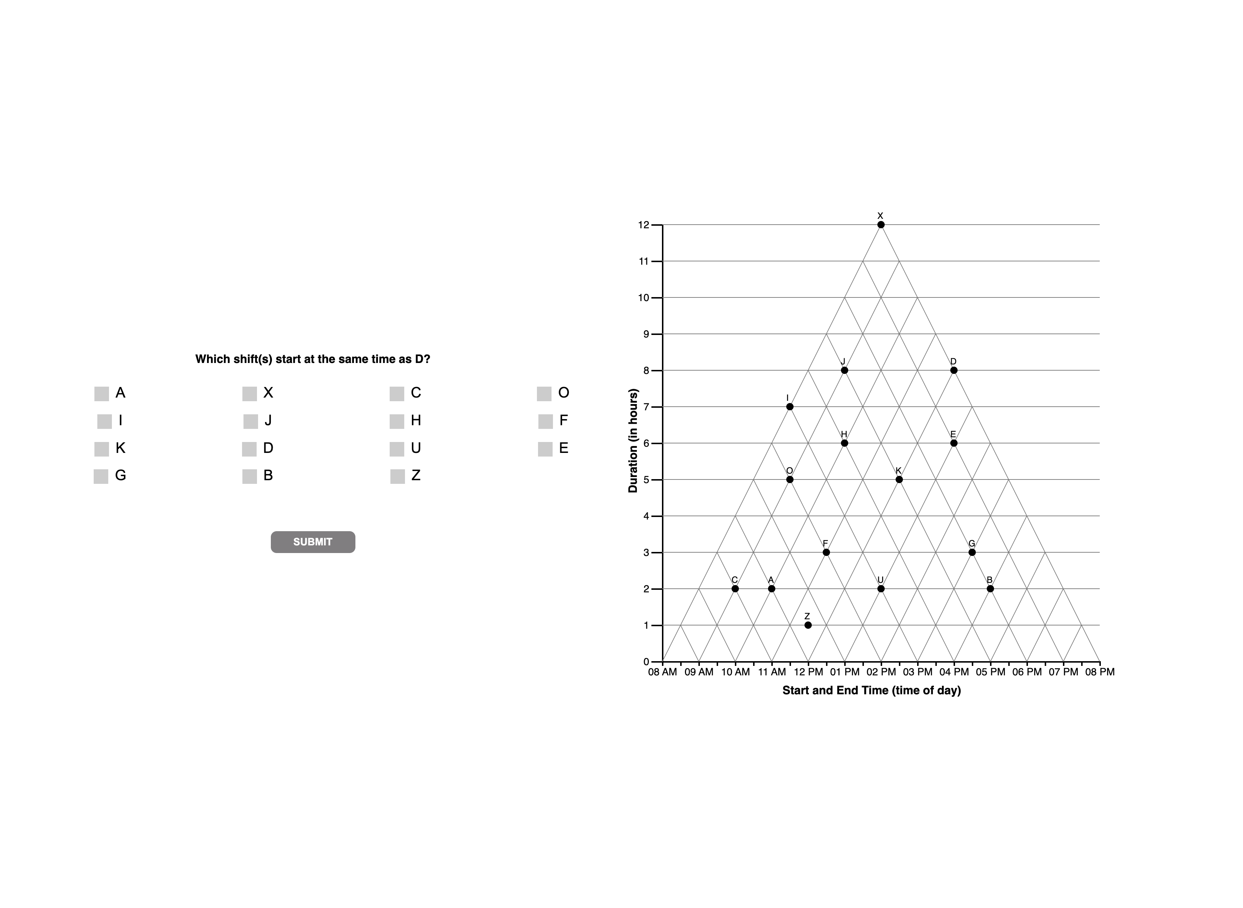

Slide 11
Question 3

Slide 12


Slide 15
Question 4

Slide 16


Slide 18
Question 5

Slide 19
